Slide 1

PCB DESIGN FOR ENGINEERS
IN-DEMAND SKILLS FOR 21ST CENTURY ENGINEERING STUDENTS

Slide 2
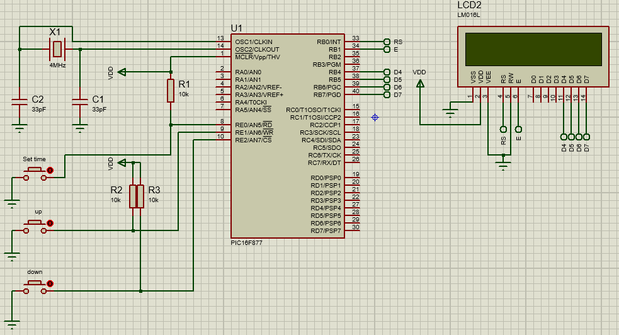
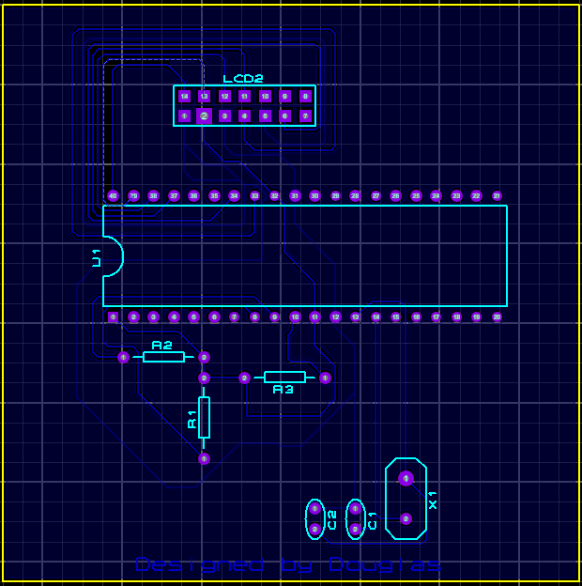
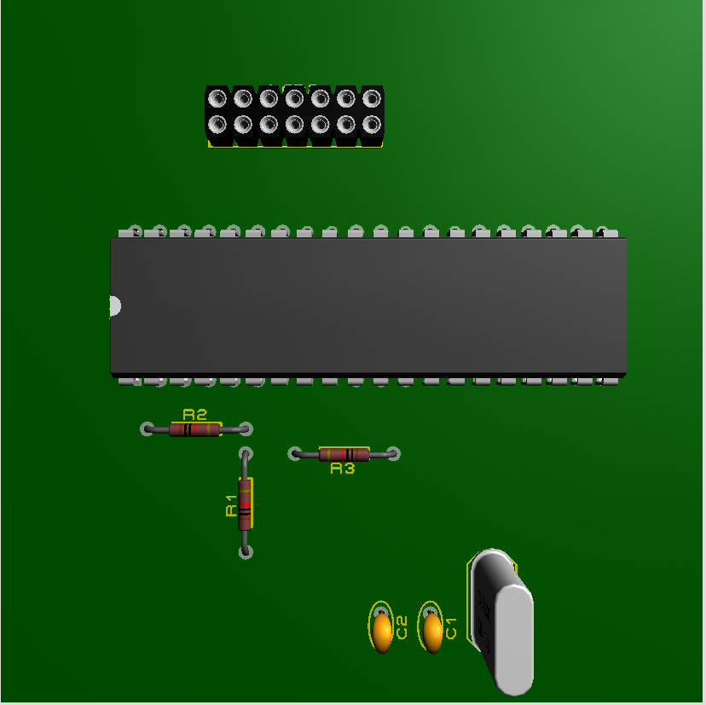
DESIGN PROCESS
Schematic
PCB Layout
Fabrication

Slide 3
PCB DESIGN SOFTWARES
PROTEUS
AUDESK EAGLE
ALTIUM DESIGN
KiCAD
EASYEDA
FRITZING

Slide 4
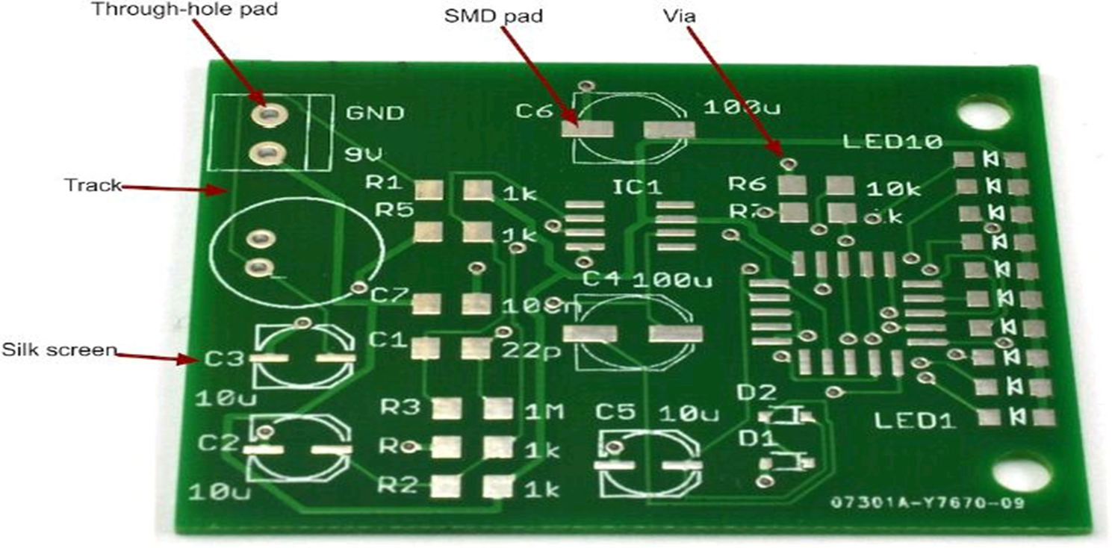
ANATOMY OF A PCB

Slide 5
DEFINITIONS OF TERMS
PADS: are where the components are soldered to the PCB.
TRACKS: are the copper tracks that connect pads together.
VIAS: are small holes through the board that link a bottom and top track together electrically.
TRACKS: on the same layer cannot cross, so often, when you are laying out a PCB, you need a signal to jump from one layer to another.
SILK-SCREENING: refers to any lettering that will appear on the final board. It is common to label components and the outline of where they fit so that when it comes to soldering the board together, it is easy to see where everything fits.
STOP MASK: is a layer of insulating lacquer that covers both sides of the board except where there are pads.

Slide 6
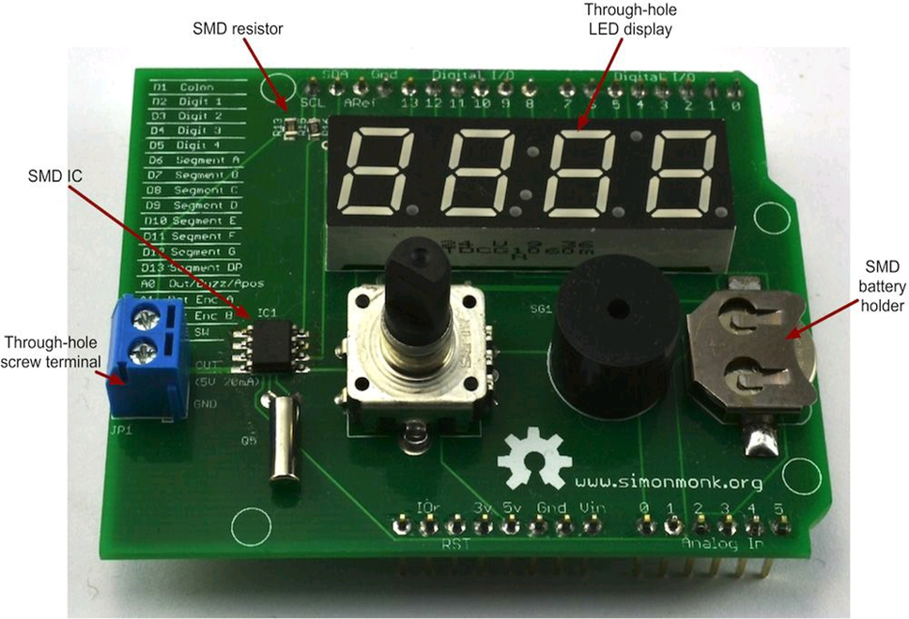
SURFACE MOUNT & THROUGH-HOLE COMPONENTS

Slide 7
Adv. Of SMD’S OVER THROUGH HOLE COMPONENTS
SMD’s are smaller and cheaper than their through-hole counterparts.
SMD boards that use them are also easier to make.

Slide 8
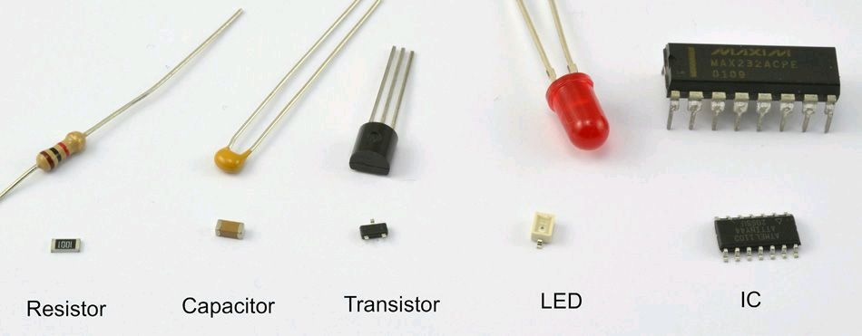
electronic components in both surface-mount and through-hole

Slide 9
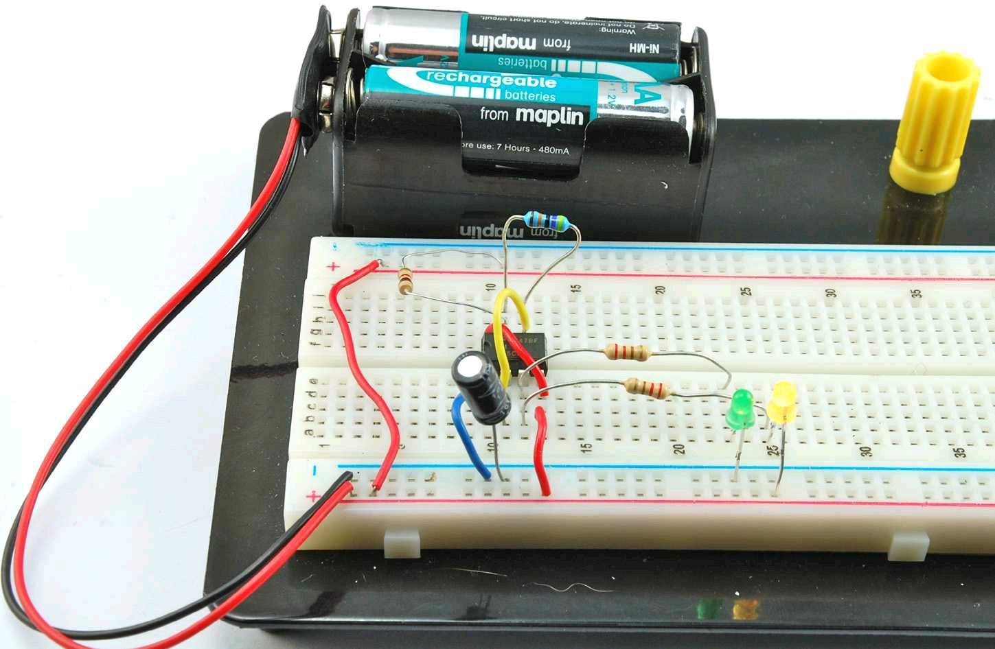
prototyping
Solderless breadboard: is very useful for quickly trying out designs before you commit them to solder.
You poke the leads of components into the sockets, and metal clips behind the holes connect all the holes on a row together.

Slide 10
Advantages & disadvantages of breadboards
The main advantage of a solderless breadboard is that it’s, well, solderless. Thus you can quickly and easily change the design just by unplugging components and leads as you need to.
The disadvantage is that wires can fall out and leads of components can touch, so a breadboard is only good for the first pass of a prototype.
The other disadvantage of breadboard is that the layout is fixed, so components end up very spaced out from each other, often with a large number of jumper wires linking everything together.

Slide 11
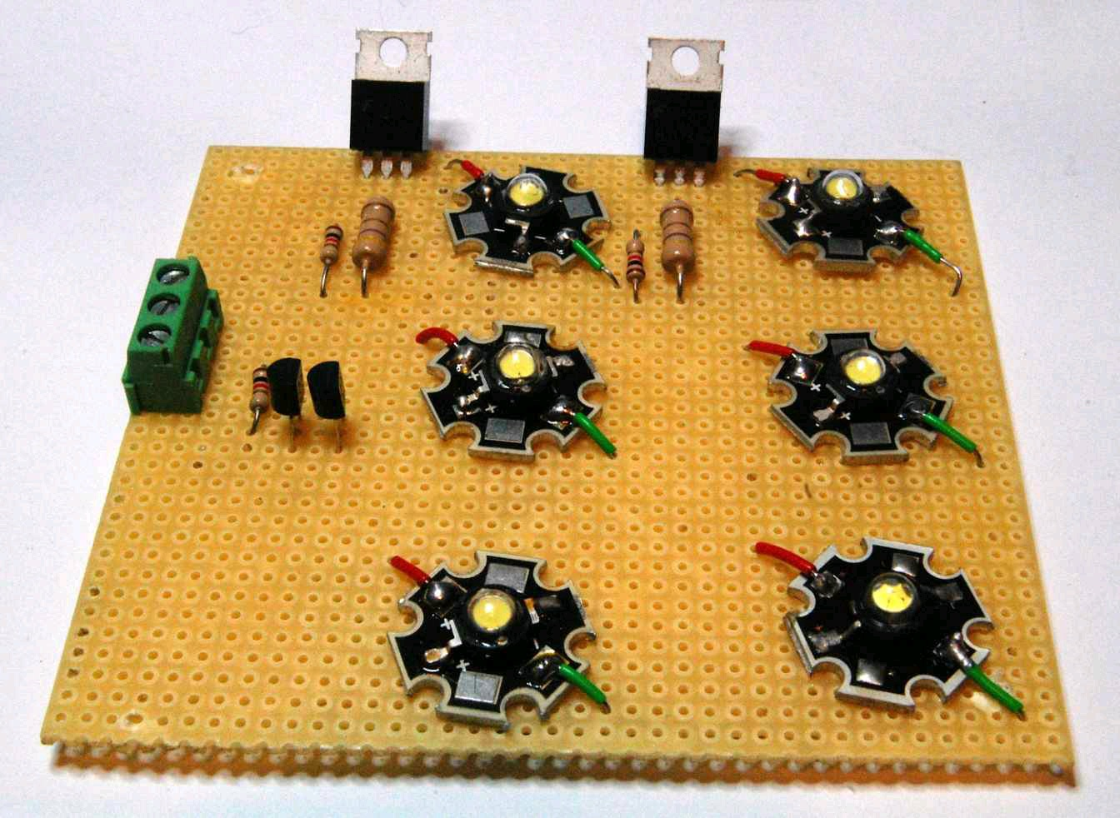
Perfboard
PERFBOARD (perforated board) is one of a number of types of board designed specifically for prototyping.
It is made from the same material as a PCB but has no copper on it.
It is just a board with an array of holes in it on a 0.1-in.

Slide 12
A variation on perfboard called protoboard is just like perfboard except that behind each hole is a copper pad.
The pads are not connected together, but they serve to hold the components tight to the board.
The advantage of perfboard and protoboard is that the layout of the components can be closer to the schematic diagram because you are not constrained to using fixed strips of connectors.
Such designs can be strong enough to deploy in a project permanently.

Slide 13
Working with Stripboard
STRIPBOARD: is a copper-clad board that has a number of copper strips running along the width of the board and contains predrilled holes positioned at a pitch of 0.1“ (2.54mm), which matches the format of standard through-hole electronic components.
It is a perforated board with conductive strips running underneath, rather like breadboard.
The copper strips allow you to join the components together to create a circuit.

Slide 14
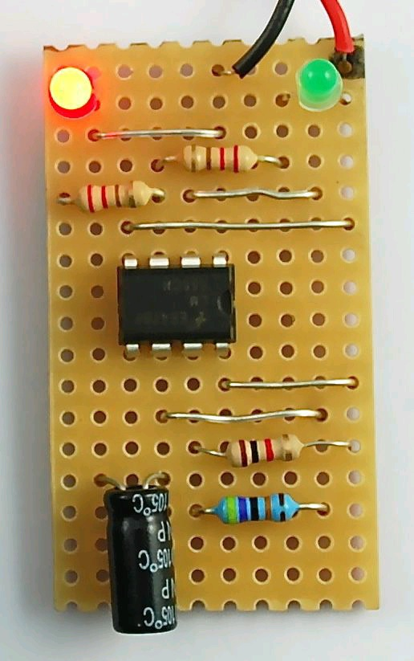
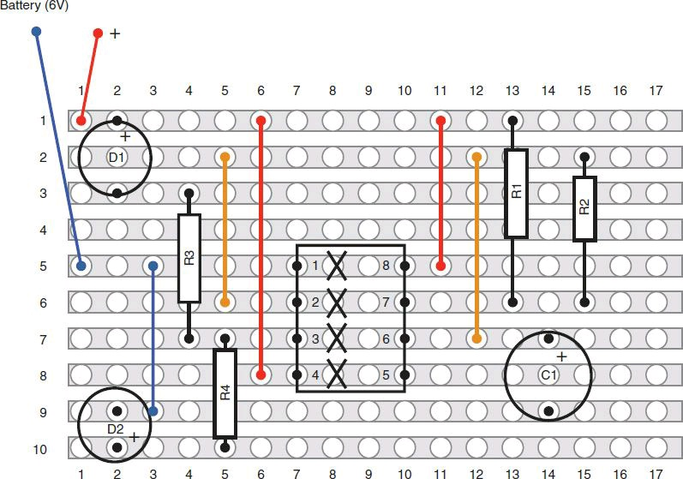

Slide 15
INSTALLING YOUR PROTEUS SOFTWARE
DEMOSTRATION

Slide 16
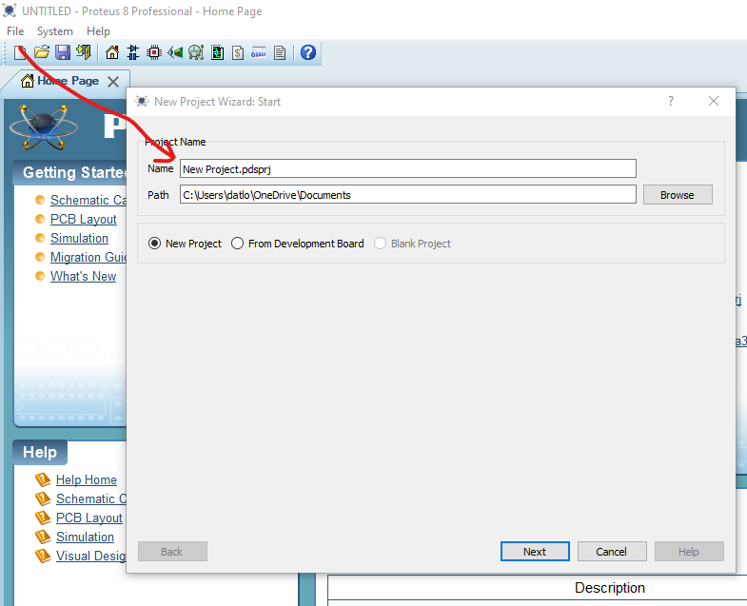
NAVIGATING IN ISIS
Starting a new project
Knowing your environment
Placing components in the work area.

Slide 17
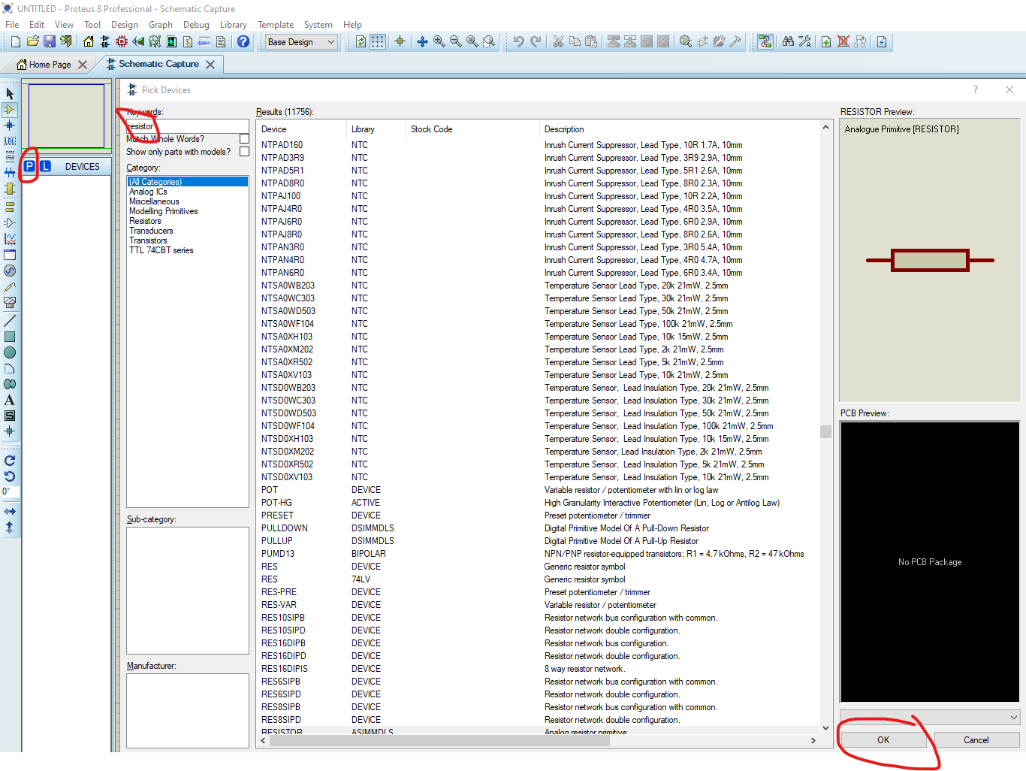
Drawing your first circuit
Placing components
Connecting components together
Simulating the circuit
Saving

Slide 18
Mastering techniques in isis
Generating Bill of Material BOM
Copying elements and blocks
Changing component properties

Slide 19
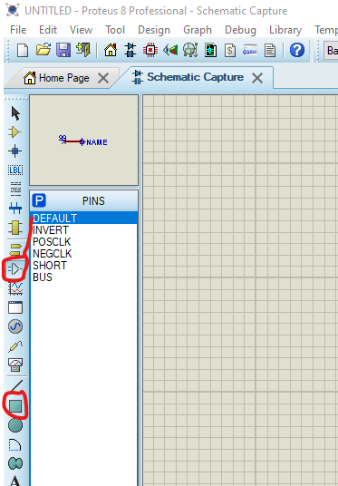
CREATING CUSTOM COMPONENTS
Drawing your element
Creating components from datasheet
Custom components cannot be used for simulation but for PCB production.

Slide 20
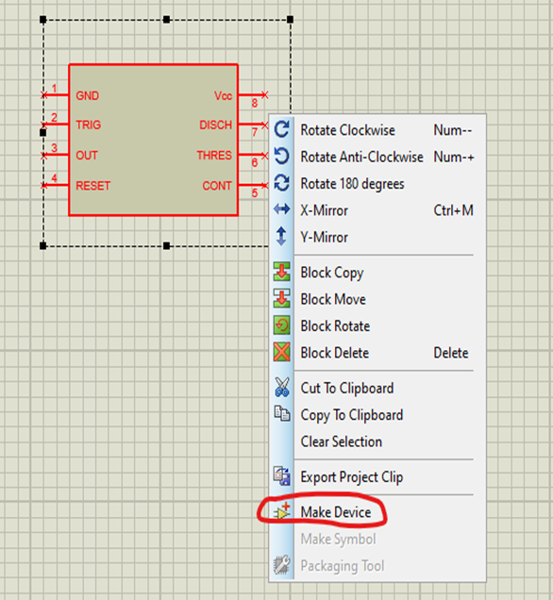
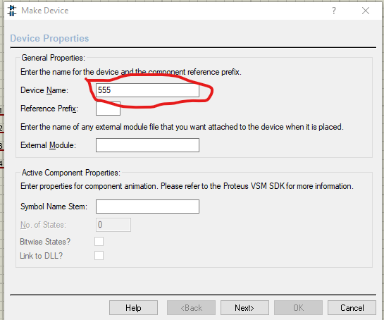
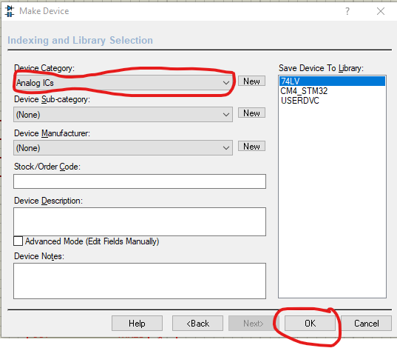
Name it and add to library

Slide 21
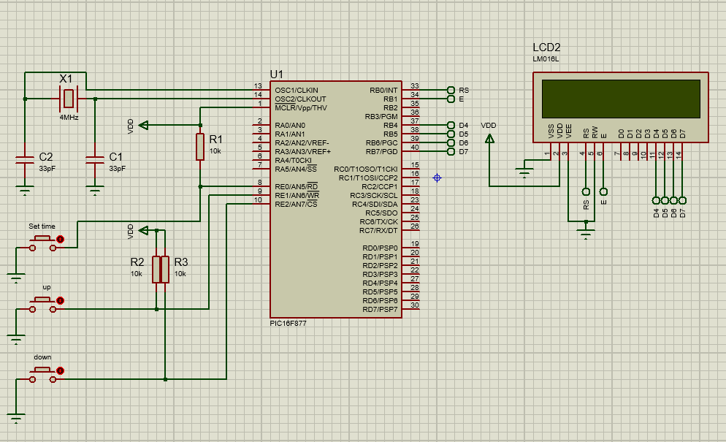
Designing complex circuits

Slide 22
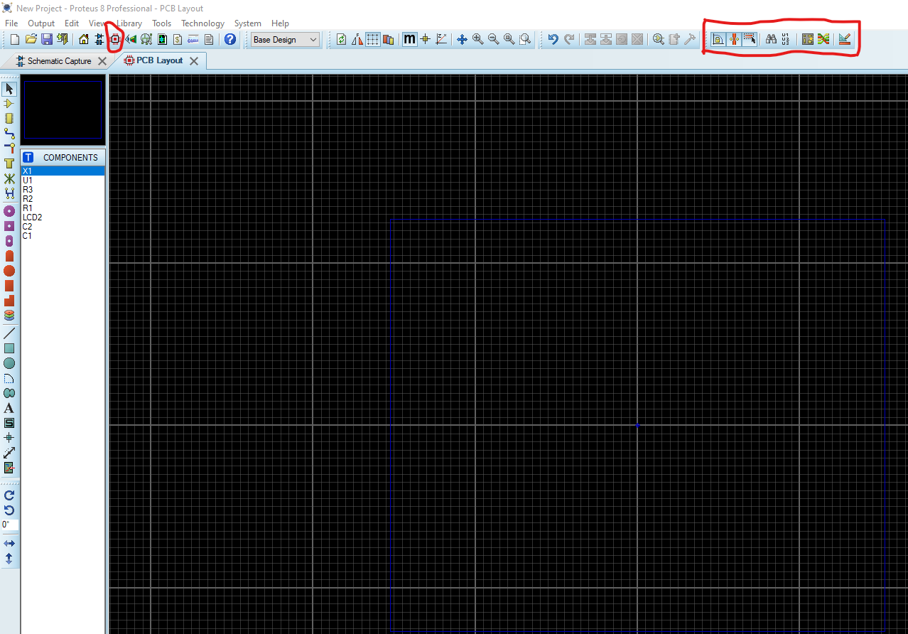
CREATING CIRCUIT PCB LAYOUT
Toolbars
Design Rule Manager
Auto-router
Auto-placer
Menus
Work Area

Slide 23
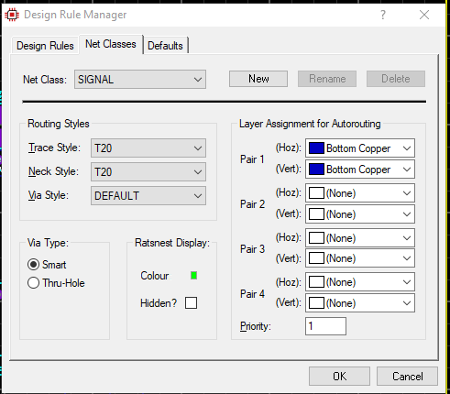
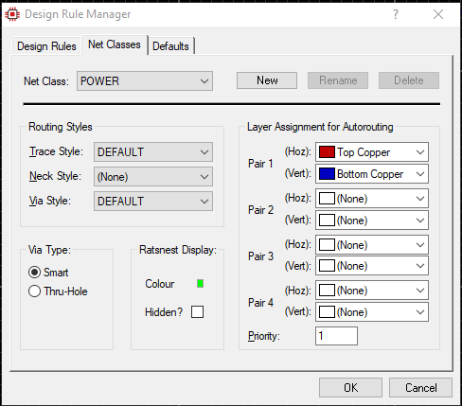
DESIGN RULE SETTINGS
Power & Signal
Trace Style – T20
Neck Style – T20

Slide 24
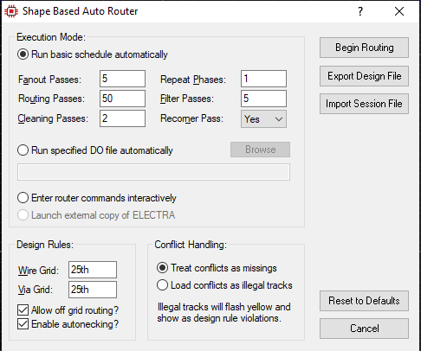
Auto-routing
Setting the DRM for Auto-routing

Slide 25
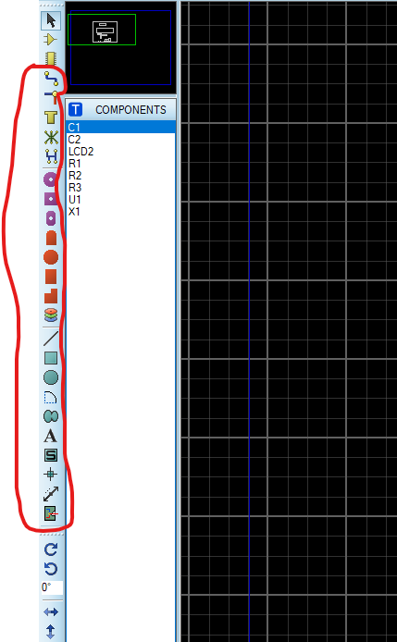
Manual routing
Tools and techniques

Slide 26

Thank you
DOUGLASAYITEY28@GMAIL.COM
TEL: 0205613190

